Slide 1
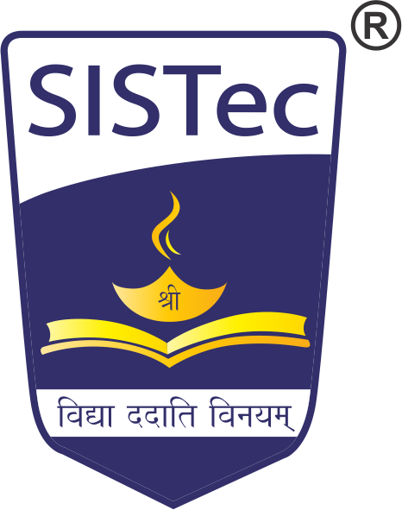
IoT based SMART BIN
Major Project - II
CS - 805
Problem Statement: An IoT-based Smart Bin Monitoring System uses ESP-32, ultrasonic sensors, DHT11, and PIR sensors to track waste levels, temperature, humidity, and detect anomalies like decomposing matter or dead bodies. Data is sent to ThinkSpeak for real-time analysis, enabling Municipal Corporations to prioritize waste collection efficiently and enhance urban waste management.
Project Group Number : 08
Group Member Details: Ankit Kishor (0187CS211029)
Amit Kumar (0187CS211023)
Abhay Prince (0187CS211003)
Amit kumar (0187CS211022)
Guide Details: Prof. Mayank Kurchaniya

Slide 2
Idea/Approach Details
Abstract:
Advancements in IoT technology have revolutionized urban waste management through smart bin systems. This project uses ultrasonic and DHT11 sensors to monitor waste levels, temperature, and humidity, transmitting data to ThingSpeak for real-time analysis. Municipal Corporations can prioritize waste collection efficiently, improving urban cleanliness. Future integration of advanced sensors, like those detecting decomposing matter, and machine learning models for predictive analysis, will further enhance functionality. The system ensures scalability, security, and a sustainable approach to smarter waste management in Smart Cities.
Describe your idea Solution/Prototype here:
Sensor Integration: Equip smart bins with sensors (ultrasonic, DHT11, PIR) to monitor waste levels, temperature, humidity, and detect anomalies like decomposing matter or dead bodies.
IoT Gateway: Use IoT gateways to aggregate sensor data and securely transmit it to the ThingSpeak cloud platform for real-time monitoring and analysis.
Alerts & Notifications: In case of critical conditions (e.g., full bins or unusual activity), send automatic alerts to Municipal Corporation officials for immediate action.
Bin History: Maintain a complete history of bin data, enabling better waste management and long-term trend analysis.
Machine Learning Integration: Implement machine learning models to predict waste collection needs and optimize resource allocation for efficient urban waste management.
Describe your Technology stack here:
Prototype Board: Breadboard
Development Board: Arduino,ESP32.
Sensors: PIR,DHT11,UltraSonic.
IDE: Arduino IDE.
Data Visualization: ThingSpeak.
App: Android.

Slide 3
Earlier’s Problems
Limited Real-Time Monitoring: Traditional waste management systems relied on manual checks, making it difficult to monitor bin levels in real-time and prioritize waste collection efficiently.
In-Person Dependency: Municipal workers had to physically inspect bins, which was time-consuming, labor-intensive, and often led to delays in waste collection.
Fragmented Data: Waste data was not centralized, making it challenging for Municipal Corporations to make informed decisions about resource allocation.
Lack of Continuous Monitoring: Without continuous monitoring, bins often overflowed before being emptied, leading to unsanitary conditions and public health concerns.
Delayed Response: Delays in identifying full bins resulted in inefficient waste collection schedules and increased operational costs.
High Cost of Management: Manual monitoring and inefficient collection processes increased operational expenses for Municipal Corporations.
Inefficient Resource Allocation: Without data-driven insights, waste collection routes and schedules were not optimized, leading to wasted resources and environmental issues.

Slide 4
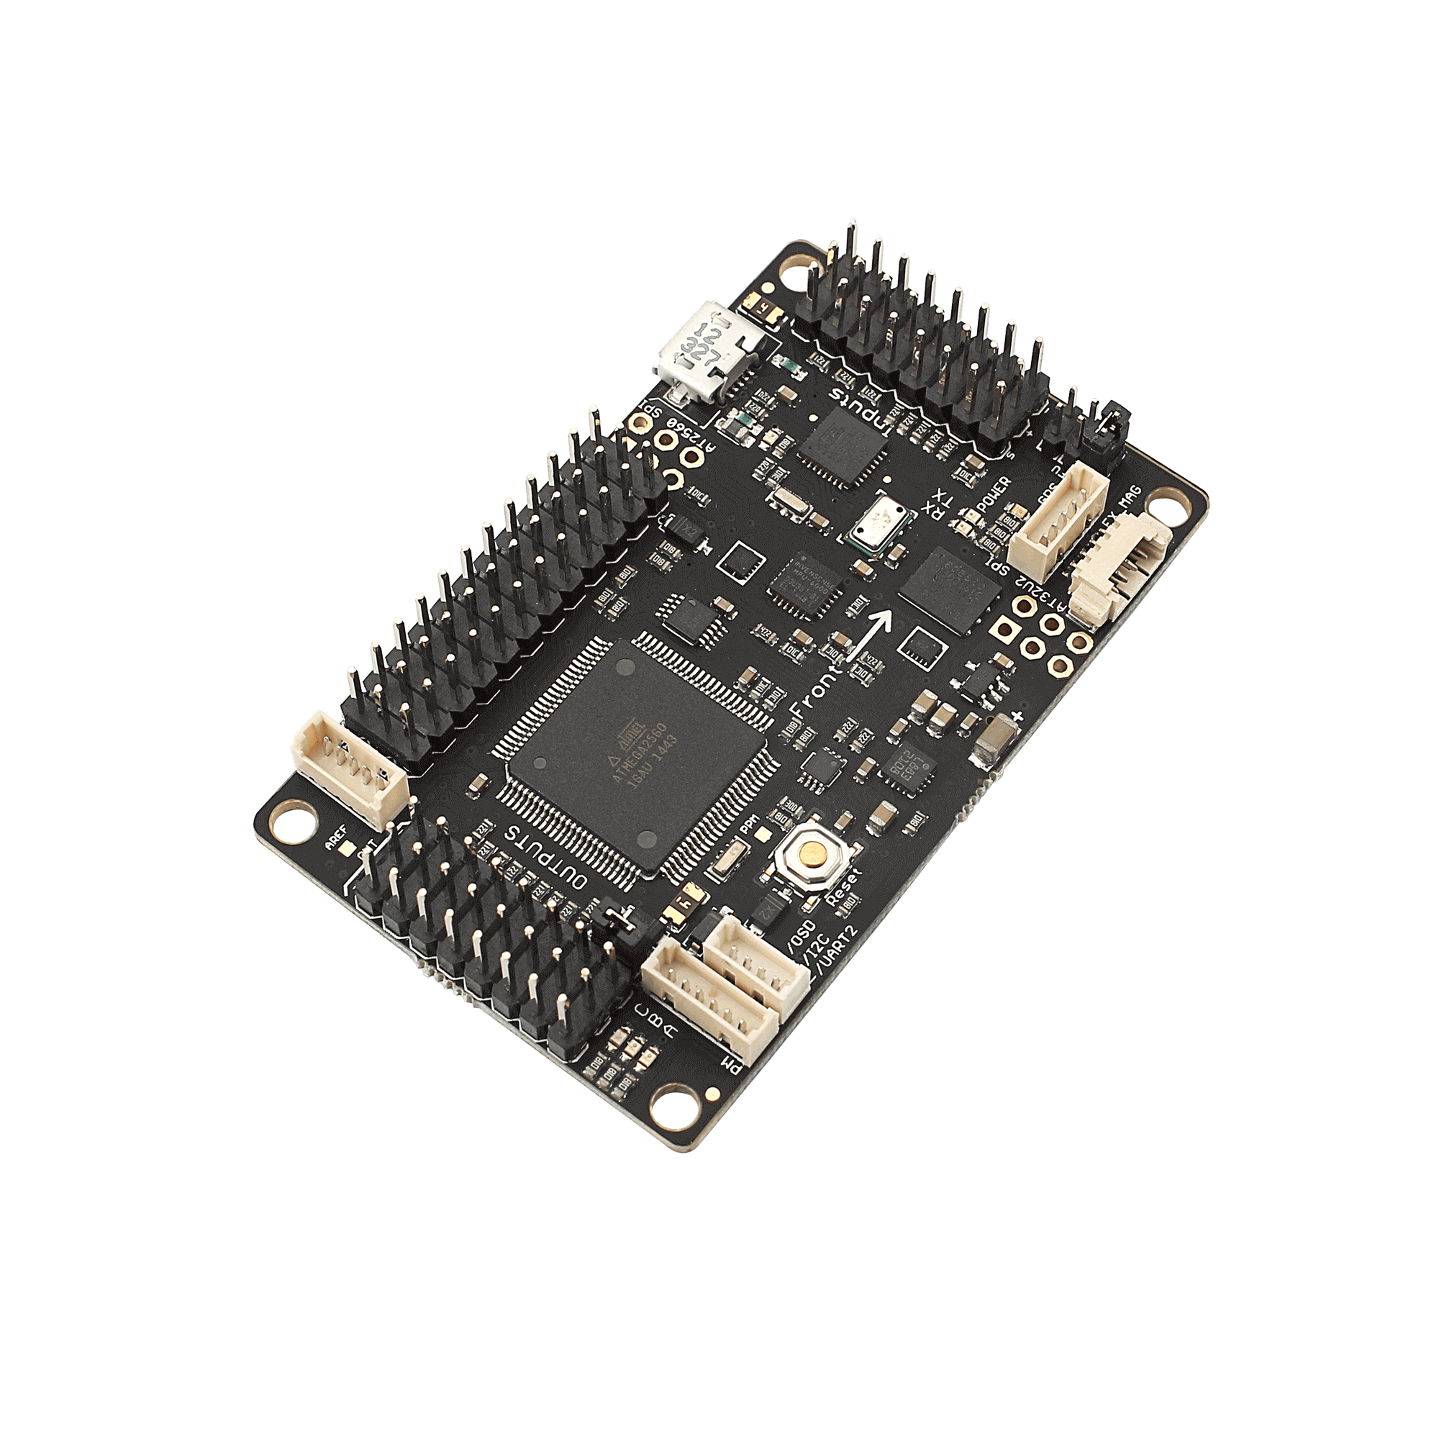
ESP32
Overview :ESP32 is a low-cost, low-power system on a chip (SoC) developed by Espressif Systems, widely used in IoT applications for its versatility and robust wireless communication features.
Microcontroller :It is based on a dual-core Tensilica Xtensa LX6 microprocessor (or single-core in some models), running at up to 240 MHz.
Wi-Fi Connectivity :The ESP32 includes built-in Wi-Fi (802.11 b/g/n) capabilities, allowing it to connect to wireless networks and function as both a client and an access point.
Bluetooth :It supports both Bluetooth 4.2 and Bluetooth Low Energy (BLE), making it ideal for short-range wireless communication in IoT applications.
Low Power Consumption :ESP32 is designed for power efficiency, featuring multiple low-power modes (deep sleep, light sleep), which makes it ideal for battery-operated IoT devices.
Cost-Effective :The ESP32 is highly affordable, making it a popular choice for DIY projects, prototyping, and mass production in IoT solutions.
Real-Time Clock (RTC) :The chip has an integrated RTC that allows timekeeping and low-power functionality while the device is in deep sleep mode.
Dual Core Processing :It can run two processes simultaneously, offering better performance for more complex applications.
Wide Temperature Range :The ESP32 can operate in temperatures ranging from -40°C to 125°C, making it suitable for industrial and outdoor applications.

Slide 5
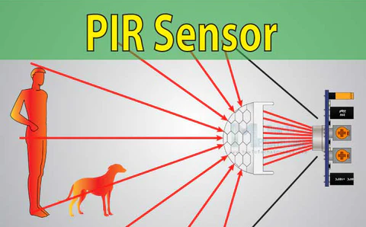
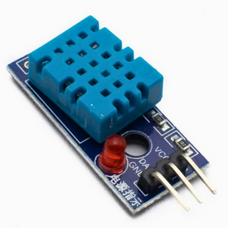
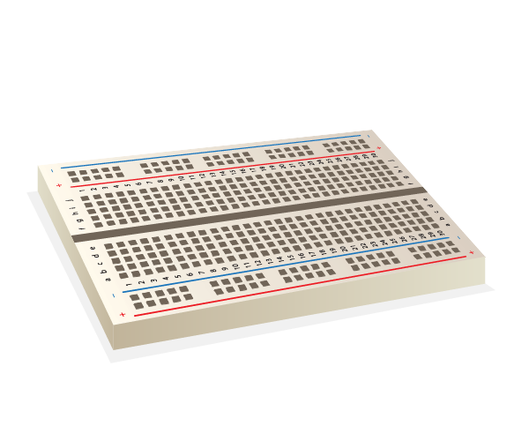
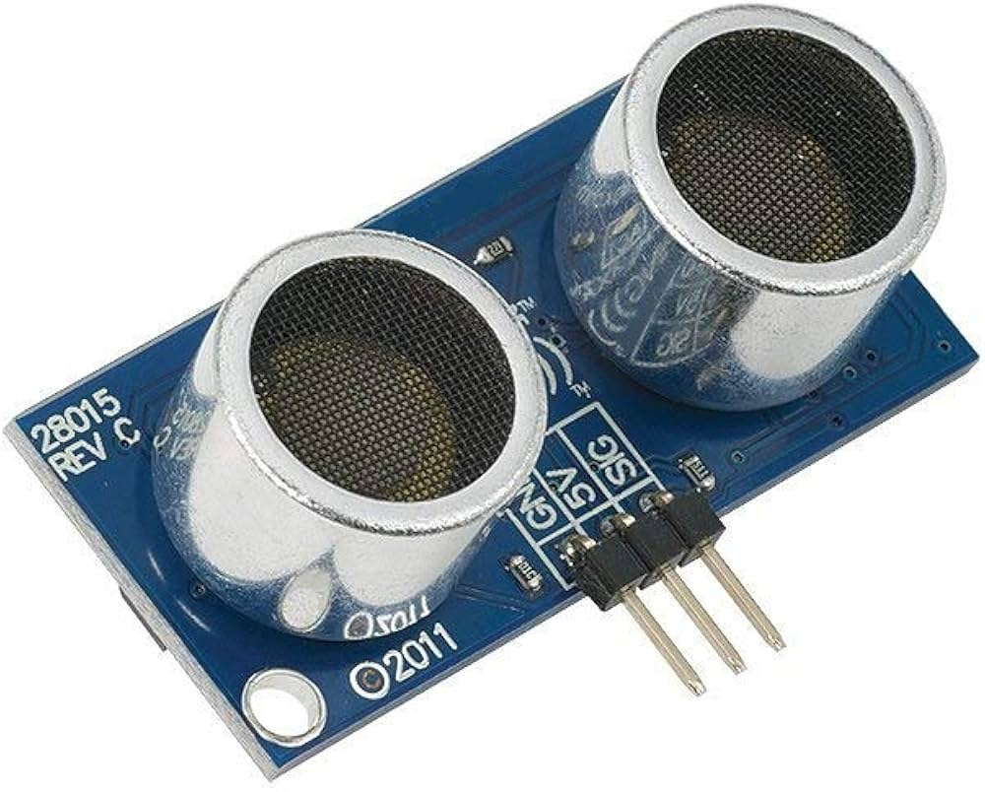
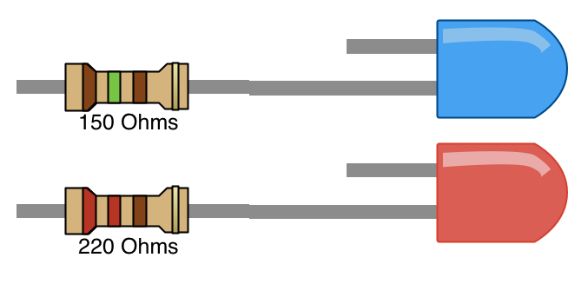
Components
PIR
DHT11
UltraSonic Distance
LEDs and Resistors
Breadboard

Slide 6
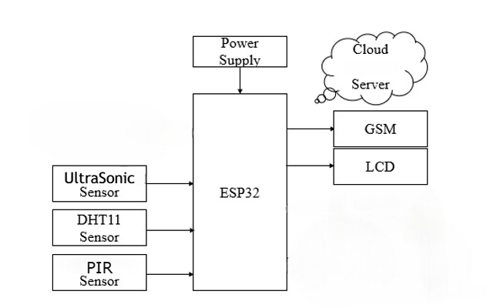
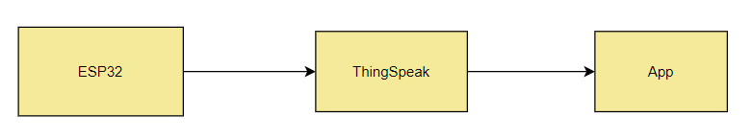
Block Diagram..

Slide 7
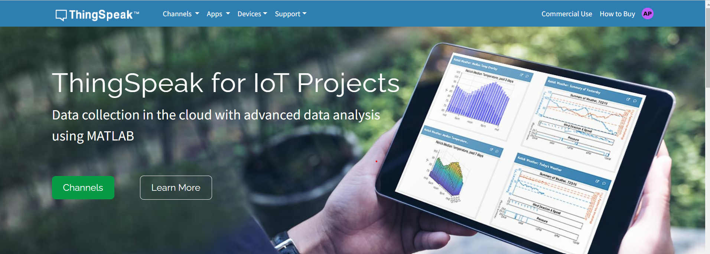
ThingSpeak..
Overview :ThingSpeak is an open-source IoT analytics platform that allows users to collect, visualize, and analyze sensor data in real time, enabling remote monitoring and control of devices.
Data Collection :ThingSpeak allows devices to send data via HTTP or MQTT protocols to its cloud-based service, where the data is stored for further analysis.
Cloud Storage :Data from sensors and IoT devices is stored in the cloud, making it accessible anytime, anywhere, and ensuring scalability for large-scale IoT projects.
Real-Time Visualization :ThingSpeak offers built-in tools to create visualizations such as line graphs, bar charts, and gauges for real-time data monitoring, enabling users to easily track changes and trends.
Integration with MATLAB :ThingSpeak is integrated with MATLAB, allowing users to apply advanced analytics, predictive models, and machine learning algorithms to the collected data for deeper insights.
Alerts and Notifications :ThingSpeak allows users to set up email or SMS notifications based on data triggers, such as exceeding sensor thresholds or specific events.

Slide 8
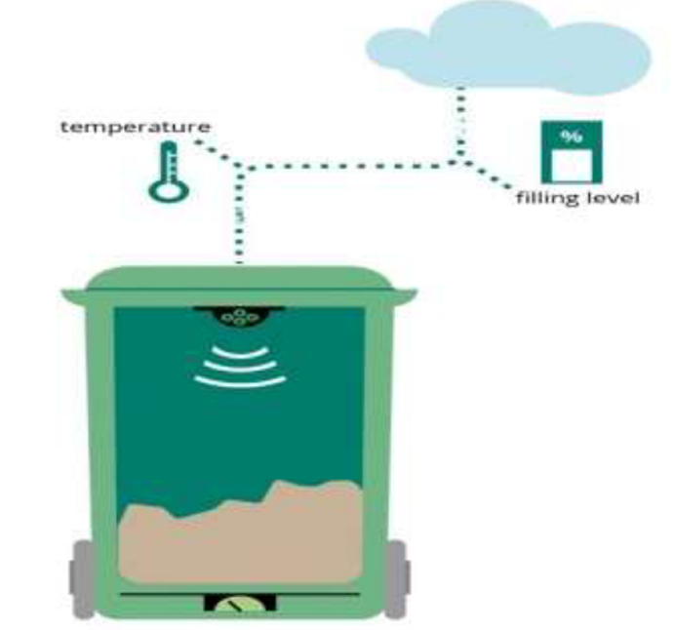
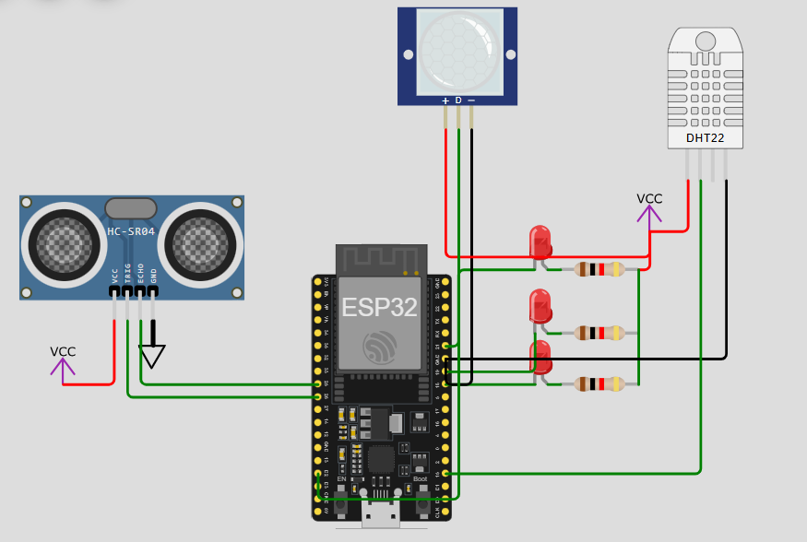
How BIN Works…

Slide 9
Conclusion & Future Inhancements..
Conclusion:
The integration of IoT technology into garbage management systems offers a transformative solution to the challenges associated with traditional waste collection methods. By leveraging real-time data analytics and automation, municipalities can enhance operational efficiency, promote environmental sustainability, and improve overall urban livability.
Future Inhancements
Enhanced Sensor Technology: Integrate advanced sensors like image recognition for precise waste level measurement and air quality sensors for pollution monitoring.
Machine Learning Algorithms: Use ML to analyze historical data, predict waste accumulation trends, and optimize waste collection routes.
Mobile Application Integration: Develop a mobile app for real-time bin fill level data, overflow alerts, and user feedback on waste management.
IoT Network Expansion: Expand the Smart Bin system to cover more locations for scalable and comprehensive waste management.
Integration with Smart City Initiatives: Align the system with smart city projects like traffic management and energy optimization for urban sustainability.

Slide 10


